Slide 1
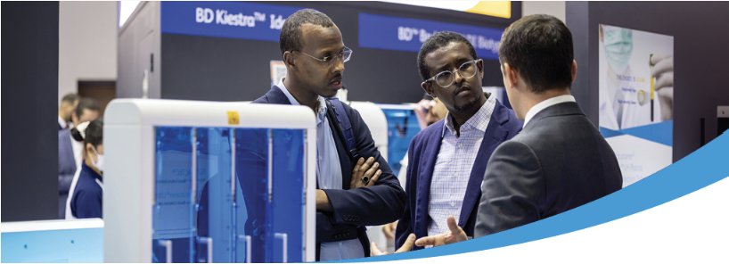
We are ready to talk business
Co-located with:
Connect now
22-24 April 2024 | Landmark Centre Lagos, Nigeria

